Slide 1
Dexur Enterprises Private Limited
AI Driven Workflow Automation & Analytics
Palthi Malleswari
N190878
1

Slide 2


Overview
Abstract
01
Technologies Used
02
Projects Involved
03
Implementation of Tasks
04
Literature Review
05
Future Scope
06
2

Slide 3
Abstract
Comprehensive Data Management Platform : Dexur provides a robust platform that enables U.S. hospitals to securely store, manage, and analyze their healthcare data efficiently.
Advanced Analytical Capabilities : The platform performs in-depth analysis of hospital data and generates actionable analytical reports to support decision-making.
Predictive Insights for CMS Star Ratings : Dexur's predictive models estimate CMS Star Ratings for hospitals and offer data-driven recommendations on key areas for improvement like Readmissions, Mortality, Safety, Patient Experience to boost scores
Enhancing Overall Healthcare Quality Metrics : positively influencing other quality measures like HRRP, Leapfrog, VBP, and MSPB.
3

Slide 4
Technologies Used
Back-end : Django , Python
Data Base : Open Search,Postgres
Query Languages : SQL For psql,DSL (Domain Specific Language) for open search
Front End : React,Java Script,HTML,CSS etc
Data Engineering : ETL Pipelines,Apache Kafka for data processing
Dev-ops : AWS services like VPC,S3,Lambda etc
Version Control : Git and GitHub
Others : Linux, Bash Scripts
4

Slide 5
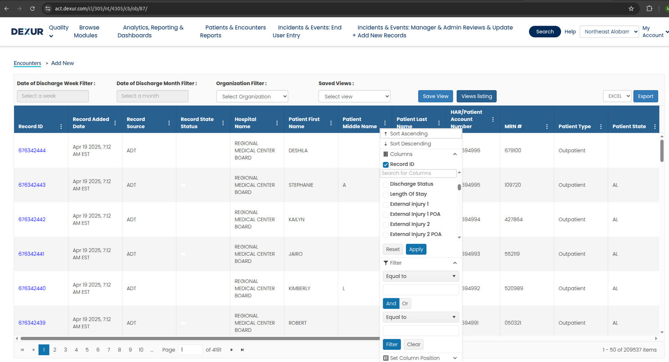
Projects Involved
Issue : Load Time for a Record Listing Page is around 9-15 sec for filters on the records
Current DB Design : All Client’s records stored in Single Table leads to this time delay as it needs to scan entire table for filters
5

Slide 6
Open Search
OpenSearch is an open-source, distributed search and analytics engine.
Originally derived from Elasticsearch 7.10, it is maintained by Amazon Web Services (AWS).
Full-Text Search : Powerful, fast, and customizable search over any text field.
Ideal for use cases like log analytics, real-time application monitoring, full-text search, and dashboarding.
Distributed Architecture : Easily scalable by adding nodes to handle more data and queries.
Query DSL (Domain-Specific Language) : JSON-based query language to build flexible, nested, and powerful queries.
Tools Available:
OpenSearch Dashboards – UI for building visualizations and queries.
Dev Tools Console – Run DSL queries interactively.
REST API / Curl / Postman – Perform queries programmatically.
6

Slide 7



Implementation
Selection of Filters and Output Columns
Selection of Filters and Output Columns
Dynamic SQL Query Generation
Dynamic DSL Query Generation
Validation
Validation
PostgreSQL Query Execution
OpenSearch Query Execution
7

Slide 8
2. Enhanced Permissions
At Dexur, we upgraded our permissions system to better match the real-world needs of our clients.
Previously, we only supported basic permissions : View records,Edit records,Add new records
Now based on client requests, we have added advanced and flexible permission controls including:
Record-Level Control
Users can only see or edit records they created.
Managers or specific user groups can be given special access.
Field-Level Control
Show or hide specific form fields based on the user’s role.
Only certain users can edit or view sensitive information.
Rule-Based Access
Permissions can now follow custom rules or conditions.
8

Slide 9
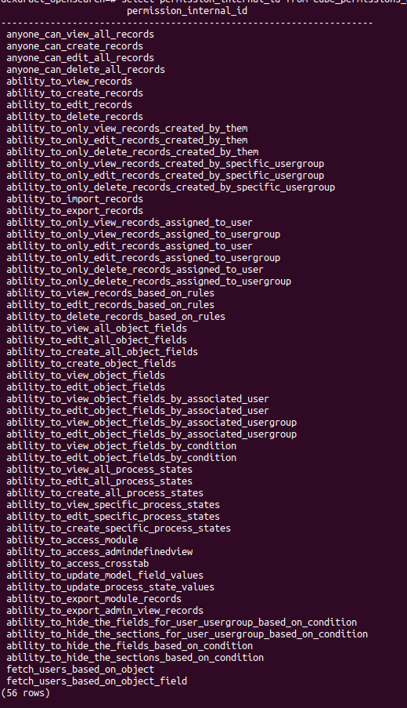
Implementation
Decorator Triggered for Permission Check
Access Denied
No permission
has permission
Execute Core Function to Handle Request
appropriate error response
errors
No errors
Return Expected Response
9

Slide 10
3. Report Builder
Intially Superset being used to generate the reports and visulaizations like charts,tables etc
Superset is essentially a data visualization and dashboarding tool that allows users to create complex charts and dashboards using SQL or no-code interfaces
Challenges with Large Data Volumes
.
Performance Issues
Heavy SQL queries may overload the database.
Complex (window functions, subqueries, multi-joins) takes 10-15 sec
Memory Usage
Visualizations involving millions of rows consume lots of memory.
10

Slide 11
OpenSearch + React
OpenSearch is designed for search and analytics on large volumes of data with high performance.
OpenSearch is designed for low-latency search and analytics across massive datasets. takes to 1 to 1.5 sec for complex queries
Benefits of OpenSearch for Analytics
Fast querying over large-scale, indexed data.
Real-time analytics with near-zero latency.
Full-text search + filters + aggregations.
Scalable horizontally.
11

Slide 12

Implementation
React Components
React components initiate API/HTTP requests
Backend Constructs Dynamic DSL Queries
backend parses the incoming API request and builds a (DSL) query based on parameters such as filters
Opensearch Query Execution
Execute the DSL Query
The raw OpenSearch response is processed and formatted into a frontend-friendly structure and returned back to the frontend for rendering.
Formatting Opensearch response
12

Slide 13
Literature Review
Training Document Provided by Company to understand the Health Care System in U.S and
Different Programs to enhance the performance of Hospitals in U.S
Training_Document
13

Slide 14
Future Scope
Better Hospital Ratings : Develop an Indian version of CMS Star Ratings for hospitals. Create metrics to evaluate patient safety, readmission rates, and mortality,
Smart AI for Health Predictions: Predict who might get complications early Show doctors a "risk score" for each patient to help decide the best treatment.Use AI chatbots to check on patients at home and alert doctors if needed.
Rural Healthcare Technology : Remote Doctor Consultations : Building Apps that Enable video calls or voice consultations between rural health workers and city-based doctors.Helps patients avoid long travel for minor illnesses.
Patient Feedback Systems & Sentiment Analysis: Modernize feedback collection and Analyze feedback text for tone, urgency, and satisfaction level.
Focus on Results, Not Just Treatments : Pay hospitals more when patients recover quickly and safely.Reduce payments for unnecessary tests or repeat admissions.
14

Slide 15
References
Opensearch : https://docs.opensearch.org/docs/latest/about/
ApacheSuperset: https://superset.apache.org/docs/intro
https://react.dev/learn
14

Slide 16
Thank you

